Slide 1

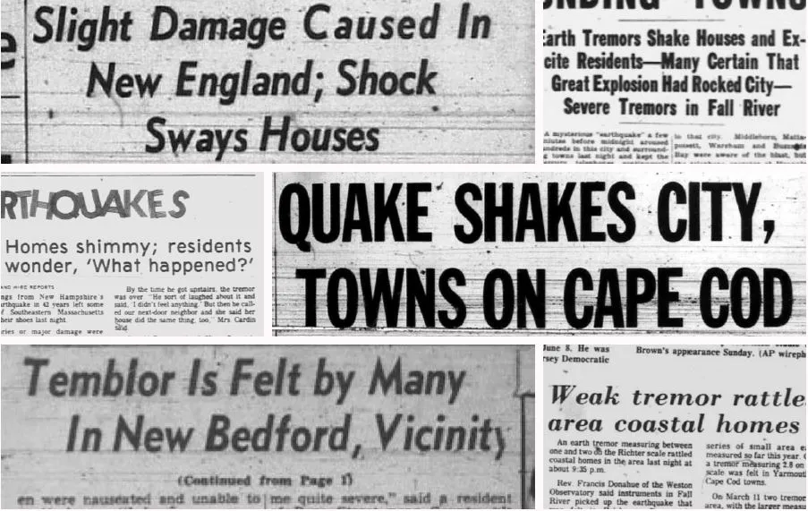





During times of crisis, many people look at social media for any information concerning the event, including first responders
How Useful is Social Media for Crisis Summaries?
________________
Breaking News
Twitter
Instagram
SND
News
MIDN 3/C Huffman, Salayon, Swanner, Tolentino

Slide 2
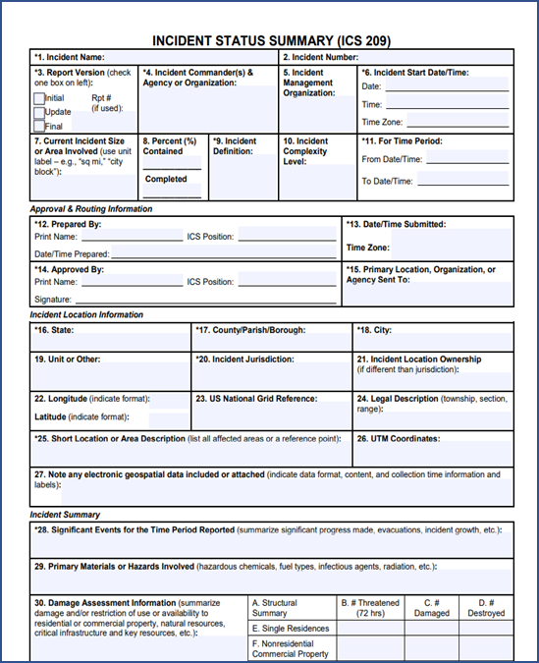
During times of crisis, many people look at social media for any information concerning the event, including first responders
How Useful is Social Media for Crisis Summaries?
Breaking News
Twitter
Instagram
SND
News
MIDN 3/C Huffman, Salayon, Swanner, Tolentino

Slide 3
FEMA ICS
During times of crisis, many people look at social media for any information concerning the event, including first responders
Breaking News
Twitter
Instagram
SND
News

Slide 4
Breaking News
Twitter
Instagram
SND
News

Slide 5
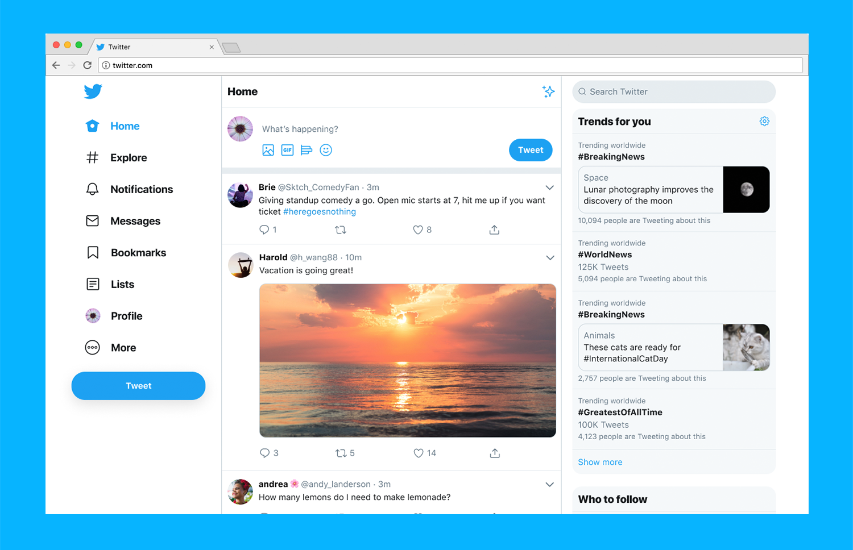

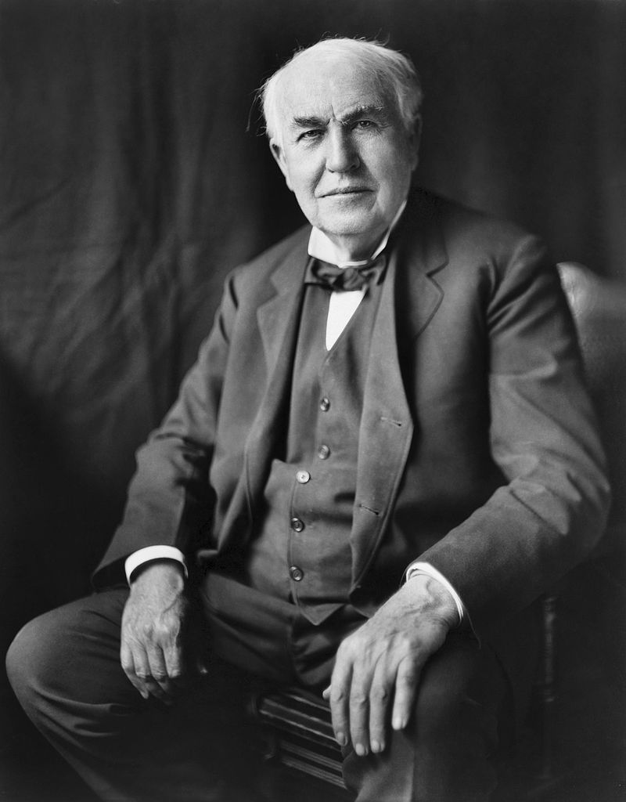
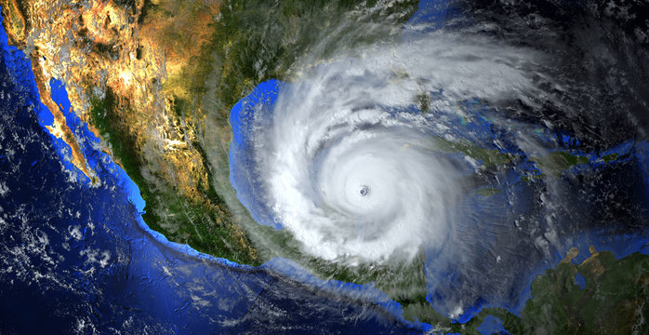

Breaking News
Twitter
Instagram
Reddit
News
Thomas E
@lightman
This hurricane is insane!!!!!
#Prayers
Alan T
@csfounder
So far there have been 10 causalities due to the 140 mph winds

Slide 6
Useful Information
Breaking News
Thomas E
@lightman
Twitter
Instagram
Reddit
News
This hurricane is insane!!!!!
#Prayers
Alan T
@csfounder
So far there have been 10 causalities due to the 140 mph winds
Not Useful Information

Slide 7
Breaking News
Thomas E
@lightman
How useful is social media in summarizing important developments during crises?
Twitter
Instagram
Reddit
News
This hurricane is insane!!!!!
#Prayers
Not Useful Information
Useful Information
Alan T
@csfounder
So far there have been 10 causalities due to the 140 mph winds

Slide 8
Thomas E
@lightman
Additional Questions
Largest Quantity?
Variation?
What information is missing?
Density?
This hurricane is insane!!!!!
#Prayers
How useful is social media in summarizing important developments during crises?
Not Useful Information
Breaking News
Useful Information
Alan T
Twitter
Instagram
SND
News
@csfounder
So far there have been 10 causalities due to the 140 mph winds

Slide 9
Additional Questions
Largest Quantity?
Variation?
What information is missing?
Density?
Breaking News
How useful is social media in summarizing important developments during crises?
Twitter
Instagram
SND
News

Slide 10
Usefulness of Information from Social Media
Breaking News
How useful is social media in summarizing important developments during crises?
Twitter
Instagram
SND
News

Slide 11
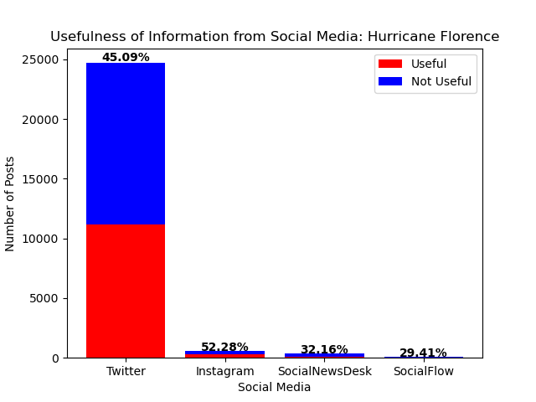
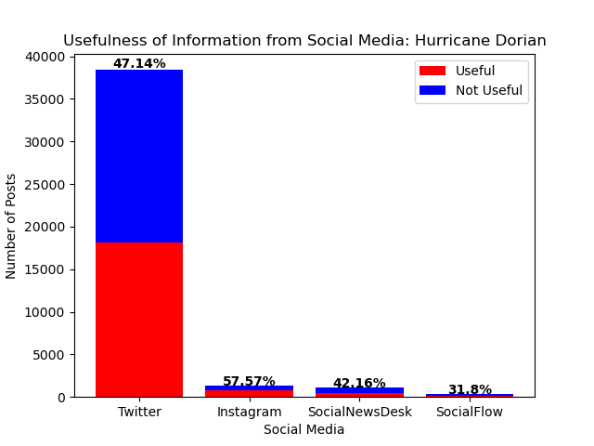
Percentage of Useful Information
Percentage Above Other Social Media Sites
Best Social Media Platform for Useful Information
Usefulness of Information from Social Media
How useful is social media in summarizing important developments during crises?
Breaking News
Twitter
Instagram
Reddit
News
Hurricane Florence
Hurricane Dorian
2:1
65%

Slide 12

Twitter
News
Best Social Media Platform for Useful Information
Variation
Percentage of Useful Information
Percentage Above Other Social Media Sites
How useful is social media in summarizing important developments during crises?
Breaking News
55%
+10-24%
Twitter
Instagram
Reddit
News
Instagram
4.567
Reddit

Slide 13
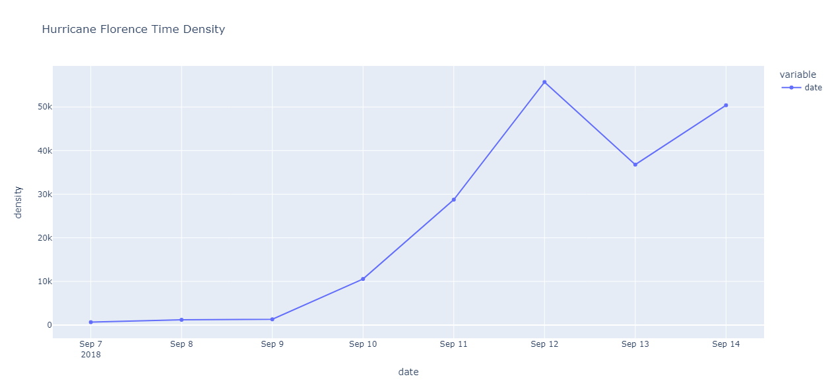
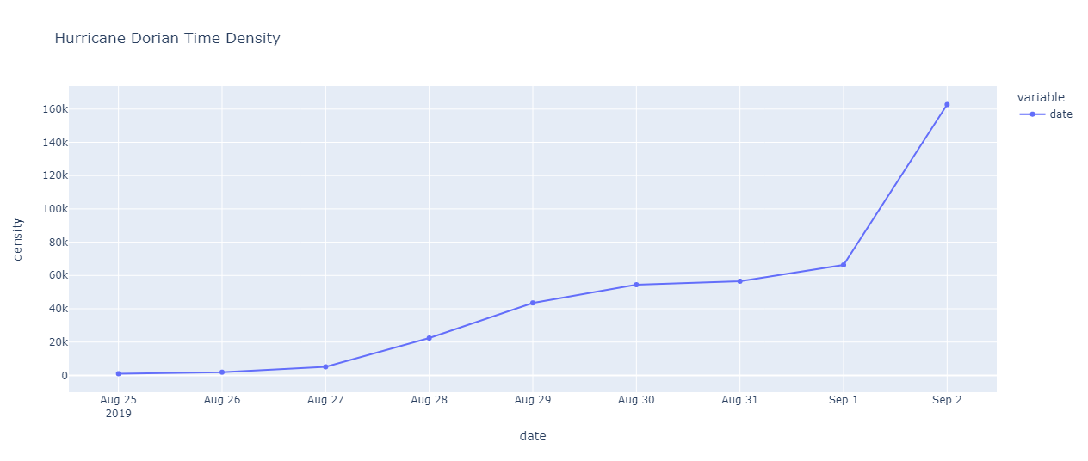
Percentage of Useful Information
Percentage Above Other Social Media Sites
Variation
Instagram
Twitter
SND
News
~11%
+10-24%
Missing Information?
Restriction to the use or availability of resources
55%
65%

Slide 14
Variation
Density of Information Over Time
Instagram
Twitter
SND
News
Hurricane Florence
Hurricane Dorian
~11%

Slide 15
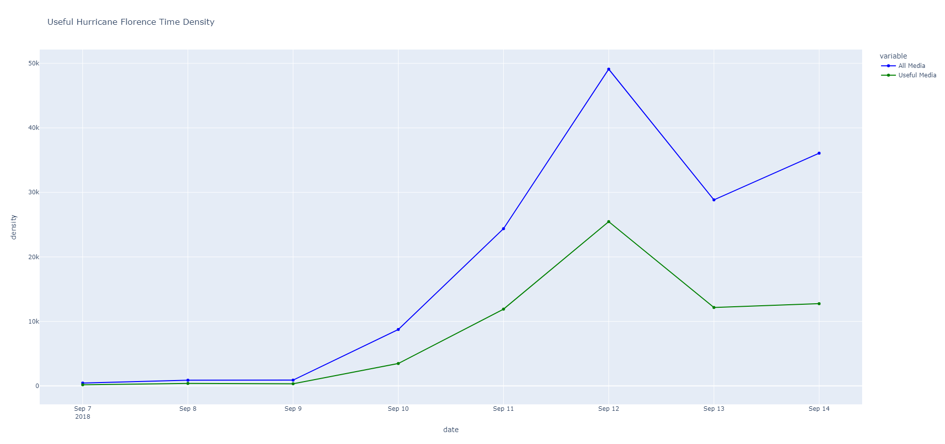
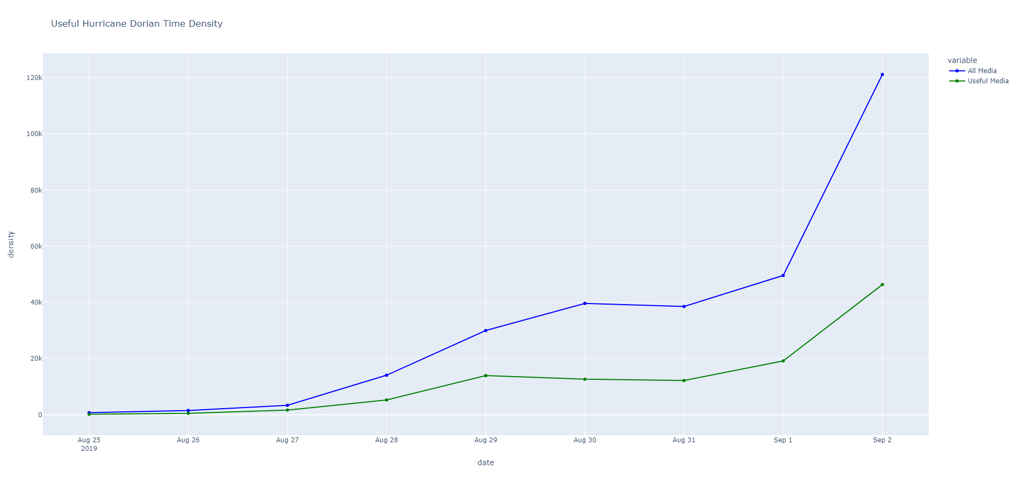
Conclusion
Density of Useful Information Over Time
Missing Information?
Restriction to the use or availability of resources
Breaking News
Twitter
Instagram
SND
News
Hurricane Florence
Hurricane Dorian

Slide 16
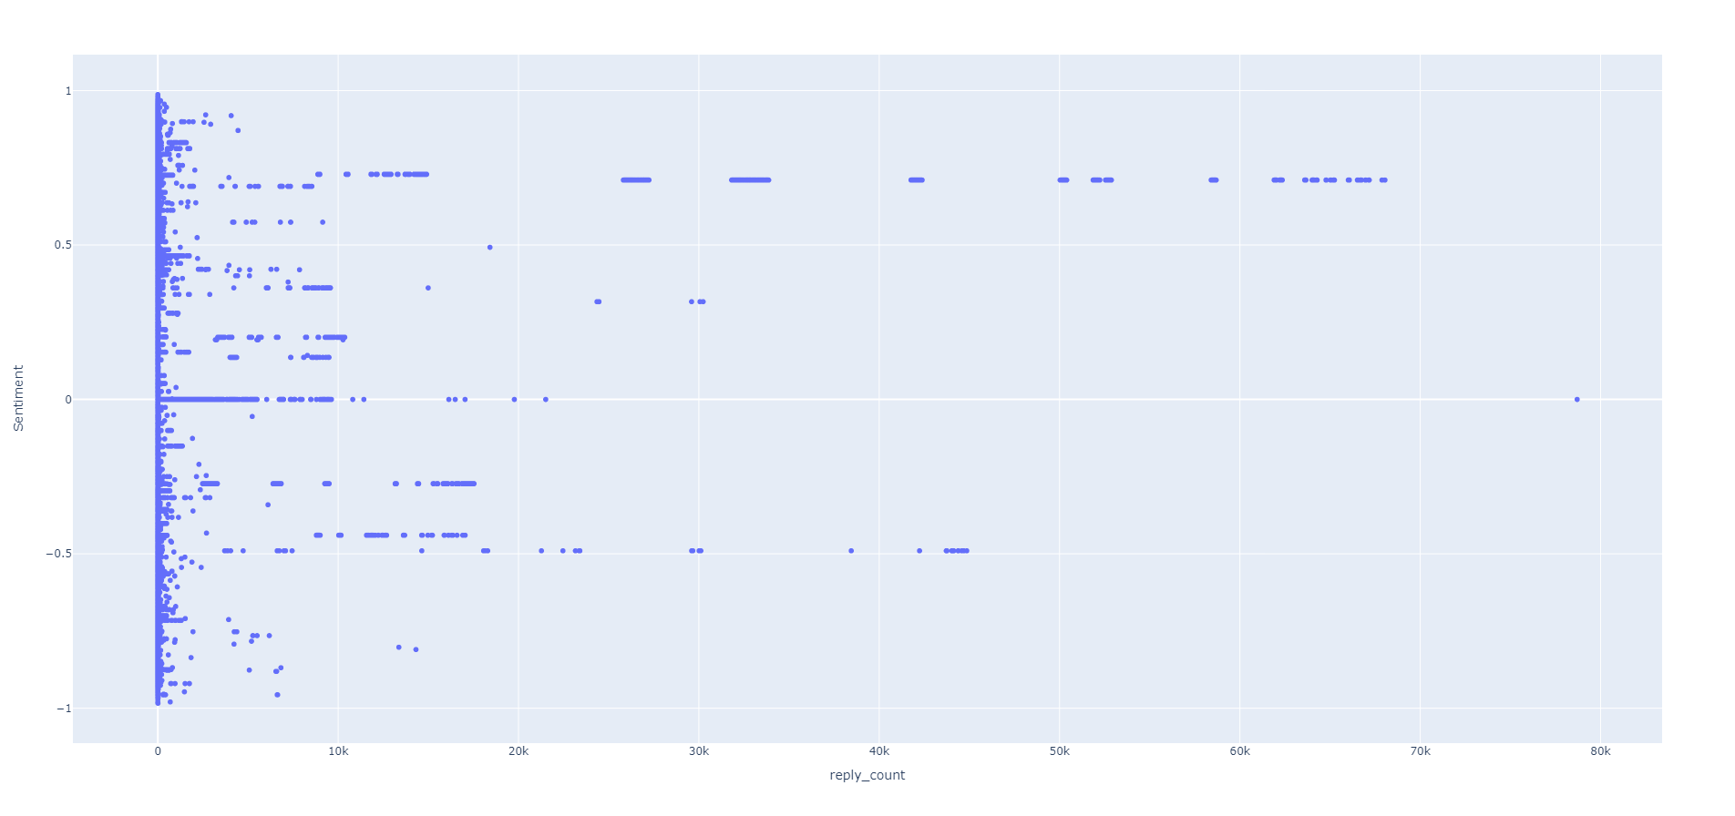
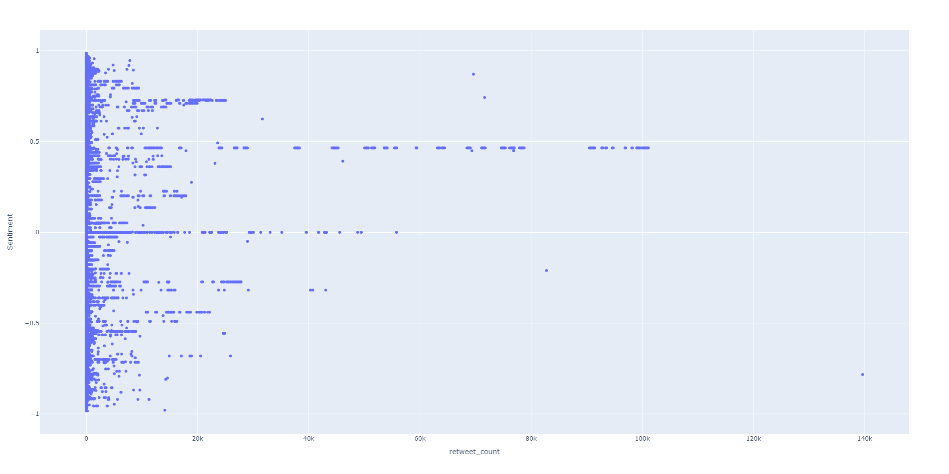
Conclusion
Reply and Retweet vs Sentiment Value
Missing Information?
Restriction to the use or availability of resources
Breaking News
Twitter
Instagram
SND
News
Reply
Retweet

Slide 17
Conclusion
Ultimately, social media was not very helpful during times of crisis
Missing Information?
Restriction to the use or availability of resources
Breaking News
1) The information was too unpredictable
Twitter
Instagram
SND
News
2) There was too much information too process
Questions?

Slide 18
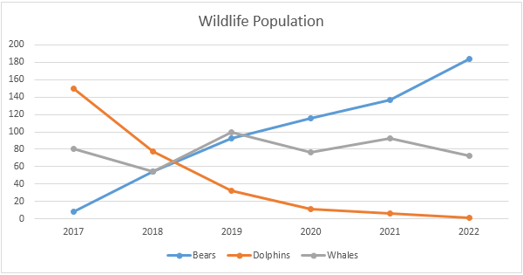
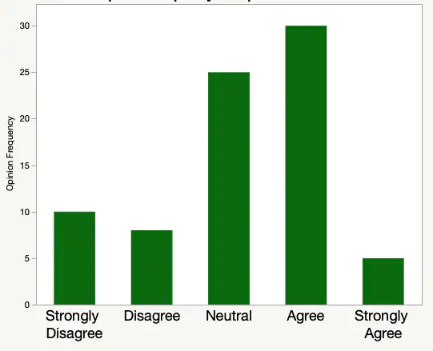

Conclusion
Missing Information?
Restriction to the use or availability of resources
Questions?
Breaking News
Twitter
Instagram
SND
News

